Slide 1




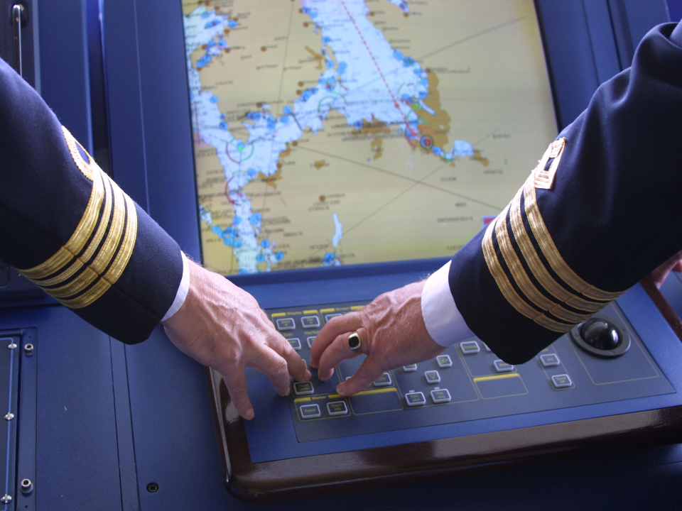
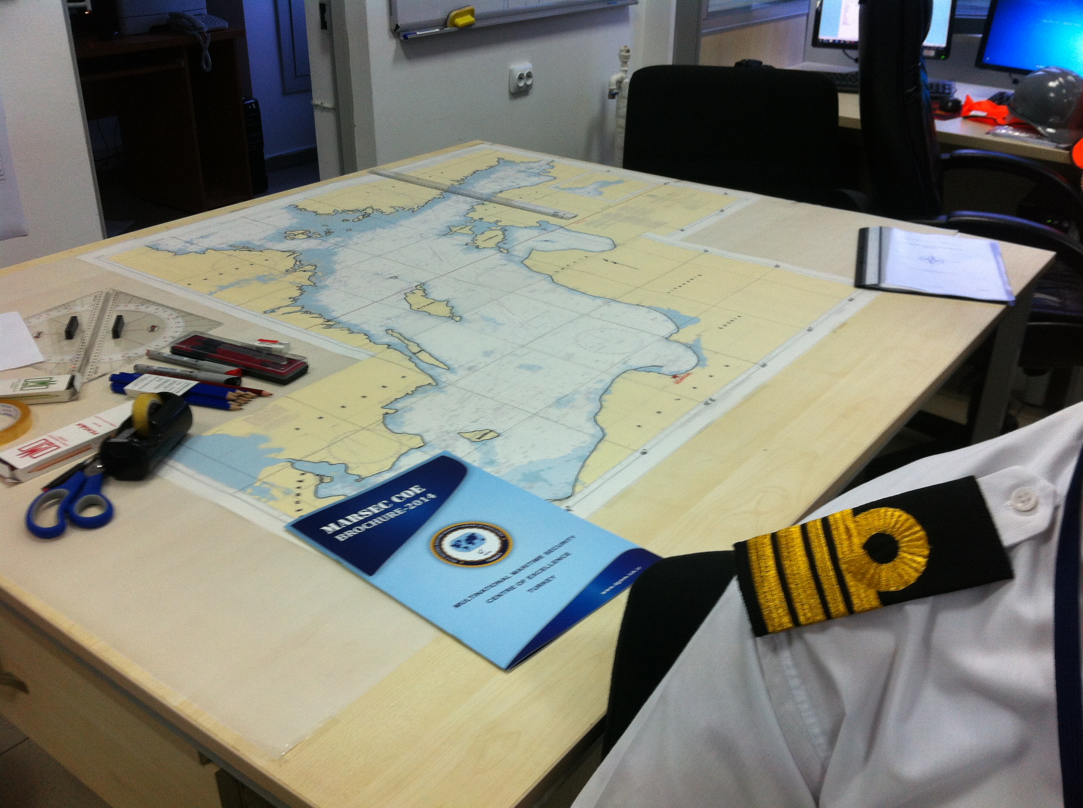
In order to both reduce conflict of interest between military and merchant shipping and to enhance safety and security at sea, NATO developed and implemented the concept of NCAGS.
Guidance can be provided to participating merchant ships to help them understand the nature and extent of the risk in an area. The acceptance of guidance is purely voluntary and intended to allow merchant ships to determine their own voyage.
In times of increased tension or conflict, additional information may be requested. The commercial sensitivity of the information supplied by the merchant shipping community will be respected and protected.
Format Alfa, a voyage/passage report, is an abbreviated form of a Ship Data Card and is the principal means by which merchant ship data is collected for use by NCAGS.
NCAGS can provide the following principal benefits to merchant shipping when cooperating with the military:
Reduced delays when transiting through military areas of operation.
Continued operation of commercial maritime transport system.
Enhanced understanding of military constraints.
Potential for reduced war-risk premiums.
Enhanced safety and security.
Improved threat response.
Naval Cooperation And Guidance for Shipping
NCAGS is the provision of Cooperation, Guidance, Advice and Assistance to merchant shipping and to enhance the safety and security of merchant ships in the vicinity of military activities like counter piracy or other military operations.
Commercial shipping relies on the principle of freedom of movement on the high seas to conduct its day to day business. Maritime trade is a fundamental strategic interest to nations dependent on freedom of movement on the seas and their economic well-being. Military operations at sea will frequently involve, or have some impact, on merchant shipping and likewise merchant shipping may affect military operations.

Slide 2
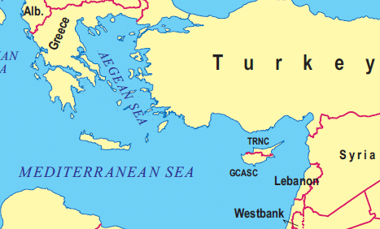
DOĞU AKDENİZ-2025 EXERCISE
The Turkish Navy Exercise DOĞU AKDENİZ-2025 NCAGS Activities takes place between 22 November - 03 December 2025 in East Mediterranean,
One of the objectives is to exercise co-operation with merchant shipping using NATO procedures and vessels are invited to participate on a no-cost/no-delay basis.
Further information is found in NAVAREA III WARNINGs and on: www.dzkk.tsk.tr
CONTACT INFO
The Deployed NCAGS Element-DNE Akdeniz is the point of contact for the exchange of merchant shipping information between Turkish Navy and the international shipping community and manned in 09:00C-17:00C between 22 November - 03 December 2025.
E-mail: turkishnavyshippingcenter@dzkk.tsk.tr
Phone : +90 242 259 33 03
(Internal: 3008)
GUIDE TO MASTERS
NATO has released a non-classified publication which covers the relationship with civilian shipping on: www.shipping.nato.int
ATP-02.
NAVAL COOPERATION AND GUIDANCE FOR SHIPPING (NCAGS) - GUIDE TO OWNERS, OPERATORS, MASTERS AND OFFICERS EDITION A VERSION 1, AUGUST 2014
NCAGS
No cost No delay
Naval Cooperation And Guidance for Shipping

